Slide 1
Digital Image Processing
Lecture # 1 (b): Introduction
Imran Siddiqi
imran.siddiqi@mcs.edu.pk
Computer Science Department
College of Telecommunication Engineering
National University of Sciences and Technology
Notes:
Good Morning! My name is Chao.
Today I like to give a topic on “Content-Based Retrieval” which so called “CBR” in multimedia systems.

Slide 2
Image Sources
Electromagnetic (EM) band imaging
  Gamma ray band images
  X-ray band images
  Ultra violet band images
  Visual light and infra-red images
  Images based on micro waves or radio waves
Non-EM band imaging
  Acoustic and ultrasonic images
  Electron microscopy
  Computer generated images (synthetic)

Slide 3

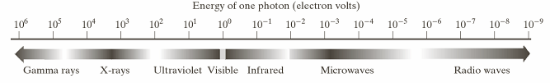
Light & EM Spectrum
EM Waves
  A stream of mass less particles each travelling in a wave like pattern, moving at the speed of light and contains a certain bundle of energy
  The electromagnetic spectrum is split up in to bands according to the energy per photon
Highest Energy
Lowest Energy

Slide 4
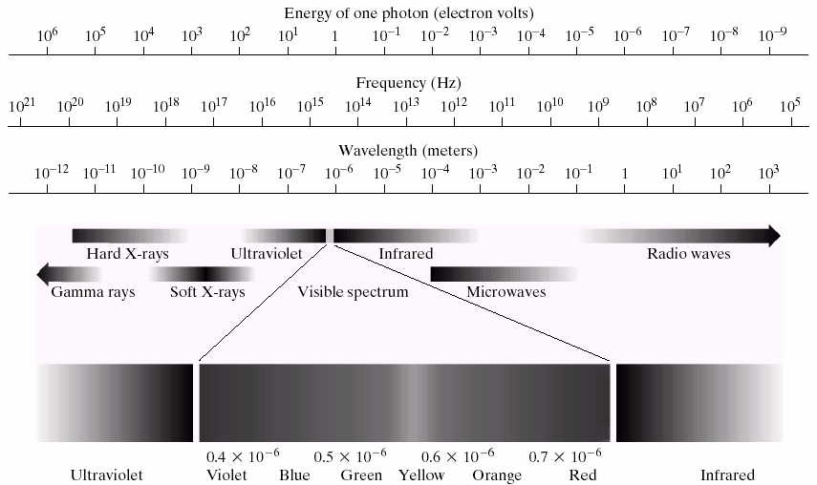

Light & EM Spectrum
Visible light is just a particular part of the electromagnetic spectrum that can be sensed by the human eye

Slide 5
Examples: Imaging in EM bands
Spectral Band | Example
Gamma-Rays | Nuclear Medicine (Radioactive isotope injected in the patient)
X-Rays | Medical Diagnostic
Ultraviolet | Fluorescence microscopy
Visible & Infrared | Remote sensing, industrial inspection, …
Microwave | Radar
Radio | Medicine – MRI

Slide 6
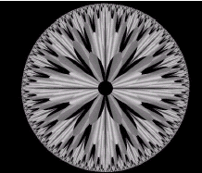
Examples: Imaging other Modalities
Sound
  Geological Applications – Oil and Gas Exploration
  Medicine – Ultrasound Imaging
Synthetic Images
  Computer generated
A synthetic image

Slide 7
Key Stages in DIP
Image Restoration
Morphological Processing
Image Enhancement
Segmentation
Image Acquisition
Representation & Description
Object Recognition
Problem Domain
Colour Image Processing
Image Compression

Slide 8
Key Stages in DIP
Image Restoration
Morphological Processing
Image Enhancement
Segmentation
Image Acquisition
Representation & Description
Object Recognition
Problem Domain
Colour Image Processing
Image Compression

Slide 9

Key Stages in DIP
Image Restoration
Morphological Processing
Image Enhancement
Segmentation
Image Acquisition
Representation & Description
Object Recognition
Problem Domain
Colour Image Processing
Image Compression

Slide 10

Key Stages in DIP
Image Restoration
Morphological Processing
Image Enhancement
Segmentation
Image Acquisition
Representation & Description
Object Recognition
Problem Domain
Colour Image Processing
Image Compression

Slide 11
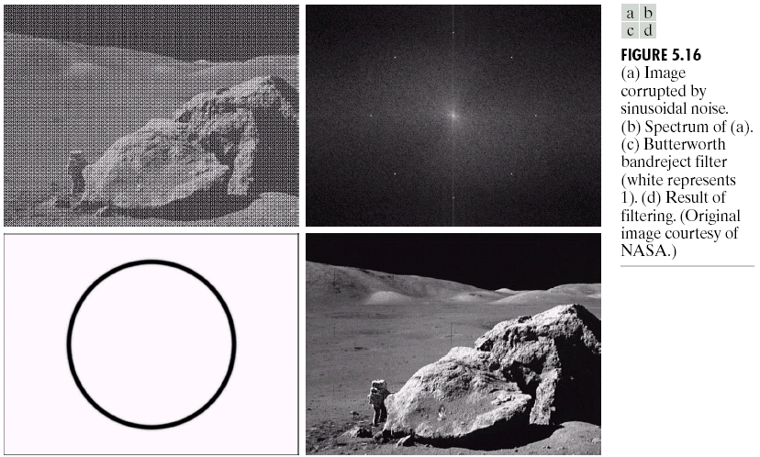
Key Stages in DIP
Image Restoration
Morphological Processing
Image Enhancement
Segmentation
Image Acquisition
Representation & Description
Object Recognition
Problem Domain
Colour Image Processing
Image Compression

Slide 12
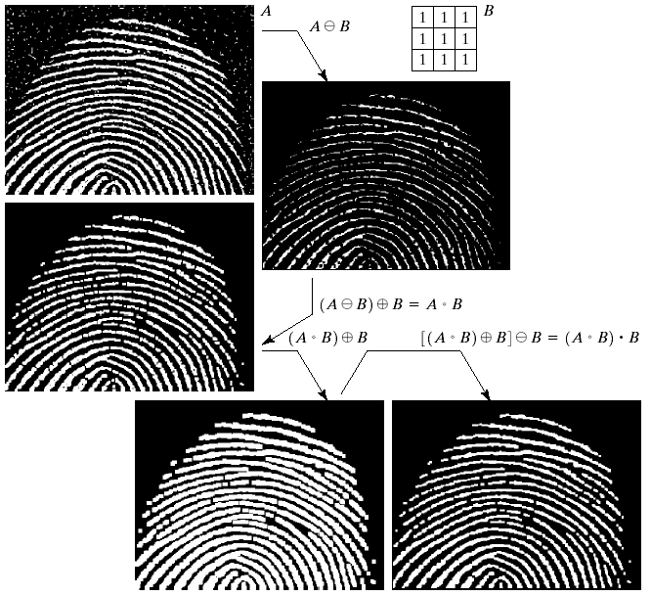
Key Stages in DIP
Image Restoration
Morphological Processing
Image Enhancement
Segmentation
Image Acquisition
Representation & Description
Object Recognition
Problem Domain
Colour Image Processing
Image Compression

Slide 13
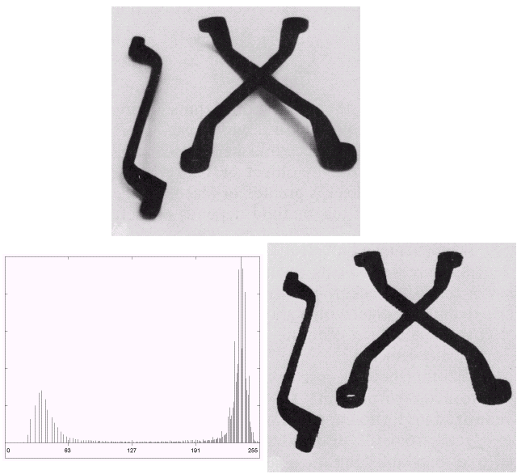
Key Stages in DIP
Image Restoration
Morphological Processing
Image Enhancement
Segmentation
Image Acquisition
Representation & Description
Object Recognition
Problem Domain
Colour Image Processing
Image Compression

Slide 14
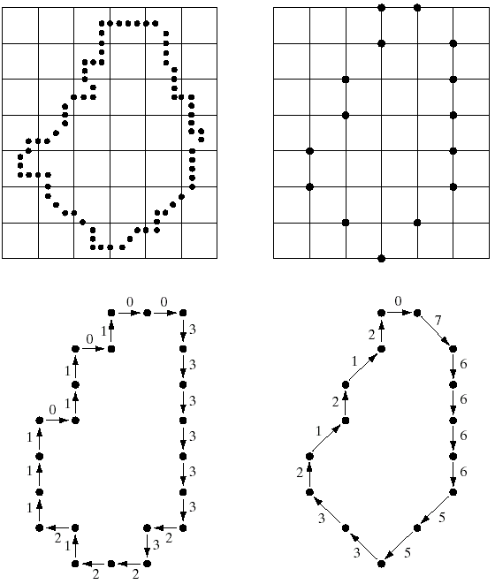
Key Stages in DIP
Image Restoration
Morphological Processing
Image Enhancement
Segmentation
Image Acquisition
Representation & Description
Object Recognition
Problem Domain
Colour Image Processing
Image Compression

Slide 15
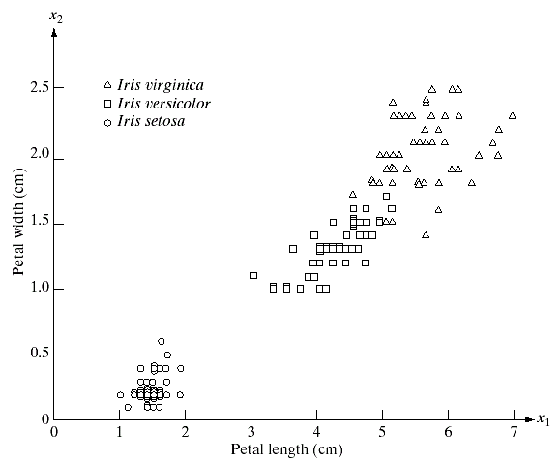
Key Stages in DIP
Image Restoration
Morphological Processing
Image Enhancement
Segmentation
Image Acquisition
Representation & Description
Object Recognition
Problem Domain
Colour Image Processing
Image Compression

Slide 16
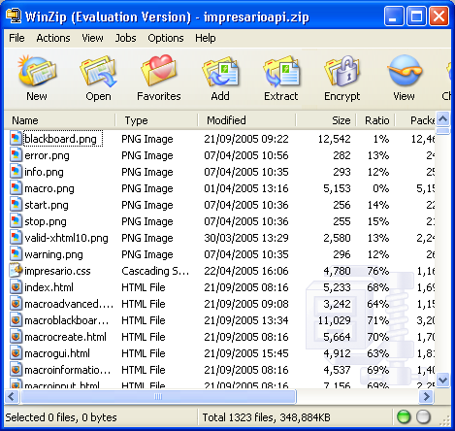
Key Stages in DIP
Image Restoration
Morphological Processing
Image Enhancement
Segmentation
Image Acquisition
Representation & Description
Object Recognition
Problem Domain
Colour Image Processing
Image Compression

Slide 17
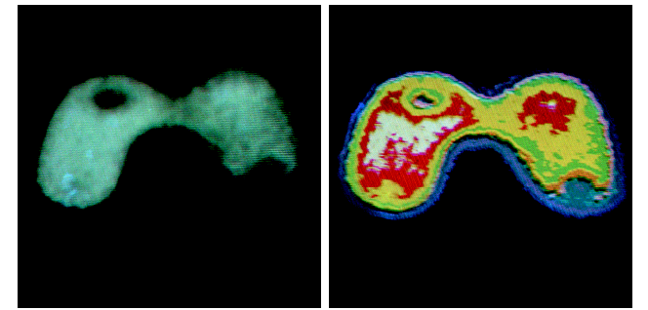
Key Stages in DIP
Image Restoration
Morphological Processing
Image Enhancement
Segmentation
Image Acquisition
Representation & Description
Object Recognition
Problem Domain
Colour Image Processing
Image Compression

Slide 18
Acknowledgements
Statistical Pattern Recognition: A Review – A.K Jain et al., PAMI (22) 2000
Pattern Recognition and Analysis Course – A.K. Jain, MSU
Pattern Classification” by Duda et al., John Wiley & Sons.
Digital Image Processing”, Rafael C. Gonzalez & Richard E. Woods, Addison-Wesley, 2002
Machine Vision: Automated Visual Inspection and Robot Vision”, David Vernon, Prentice Hall, 1991
www.eu.aibo.com/
Advances in Human Computer Interaction, Shane Pinder, InTech, Austria, October 2008
Material in these slides has been taken from, the following resources

